Slide 1

Understanding Standards

Slide 2
Administration and IT National 5
Assignment 2020
Circus in the Sky

Slide 3
What this presentation covers
Theory workshop (Task 2)
All other tasks in order

Slide 4
Resources Required
N5 2020 Administration and IT Assignment
N5 2020 Assignment Marking Instructions
Theory workshop sheets (optional)

Slide 5
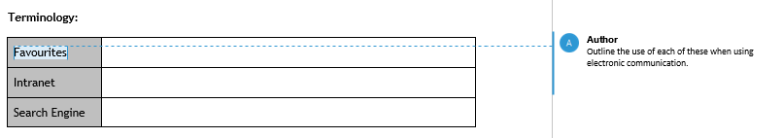
Task 2 – Theory (9 marks)
Outline the use of each of these when using electronic communication.
Outline - candidates must make a brief statement appropriate to the task. 1 mark should be given for each accurate brief statement.

Slide 6
Task 2 – Theory (9 marks) (cont)
Must be a use.
Do Not Award (DNA) marks where candidates speak of stuff/things/items, they need to be more specific, eg files/webpages/information.

Slide 7
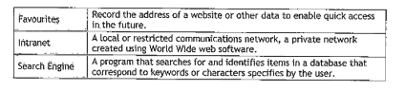
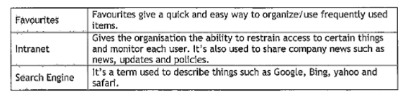
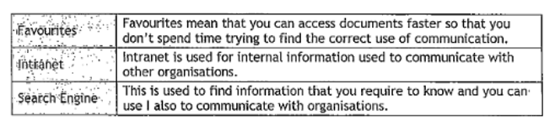
Task 2 – Theory (9 marks) (cont)

Slide 8
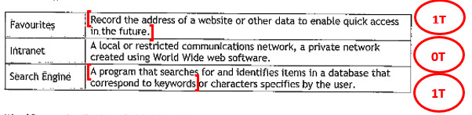
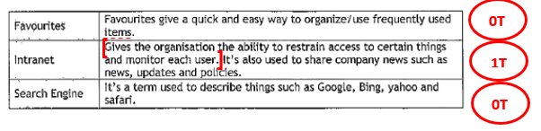
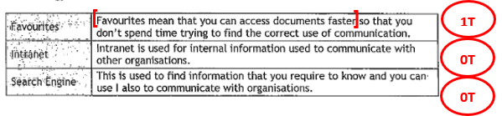
Task 2 – Theory (9 marks) (cont)

Slide 9
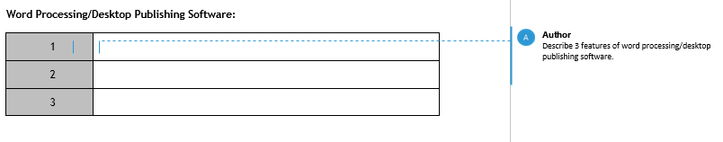
Task 2 – Theory (9 marks) (cont)
Describe - candidates must make a detailed statement, as appropriate to the task. 1 mark should be given for each accurate detailed statement.

Slide 10
Task 2 – Theory (9 marks) (cont)
Accept text formatting, then an example.
Accept any specific text formatting and a description of it.
Candidates can be awarded 3 marks for describing three different text formats.
Must be a description, not just naming.

Slide 11
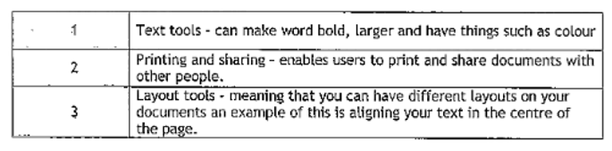
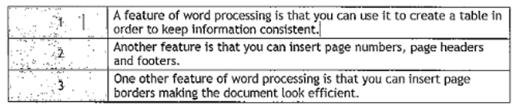
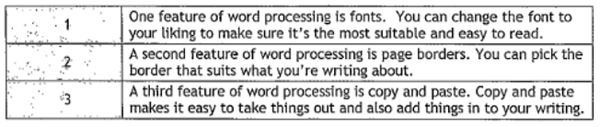
Task 2 – Theory (9 marks) (cont)

Slide 12
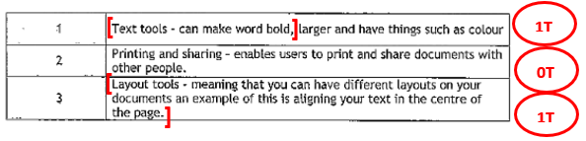
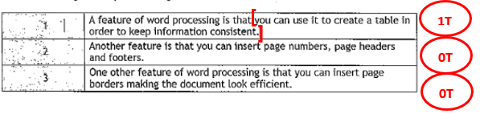
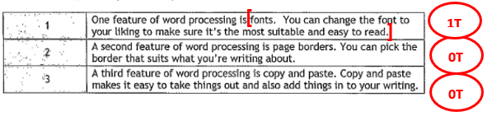
Task 2 – Theory (9 marks) (cont)

Slide 13
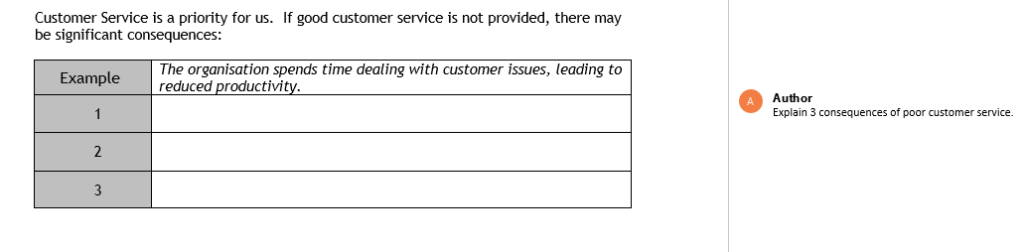
Task 2 – Theory (9 marks) (cont)
Explain – candidates must make an accurate, relevant point that relates to cause and effect. 1 mark should be given for each accurate cause and effect.

Slide 14
Task 2 – Theory (9 marks) (cont)
Check that the candidates answer is not the example given.
There must be two parts to an explain response.
More than 1 mark can be awarded in each box.

Slide 15
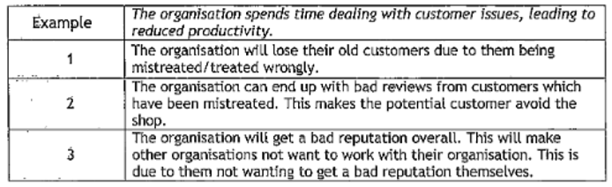
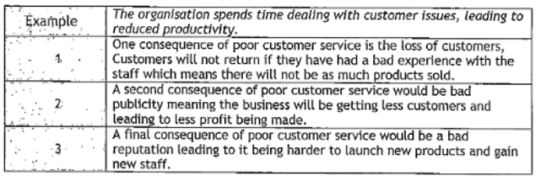
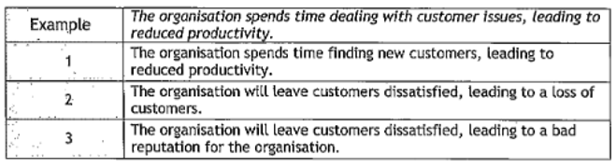
Task 2 – Theory (9 marks) (cont)

Slide 16
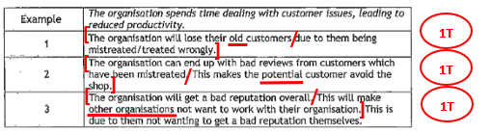
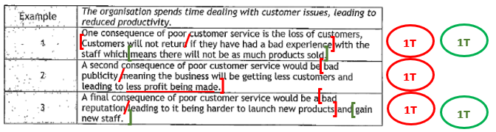
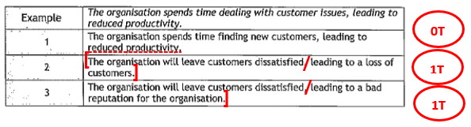
Task 2 – Theory (9 marks) (cont)

Slide 17
1 mark maximum not awarded across the paper
For example:
Circle instead of Circus.
Skill instead of Skills.
Lewis Castle or Castle Lews instead of Lews Castle.
The exclamation mark is omitted from Quest for Adrenaline!
Capitalisation of Quest for Adrenaline! – Quest For Adrenaline!

Slide 18
Task 1 – Headed Paper (6 marks)
The words e-mail, web and social media can be included.
Remember to look at the footer for text formats.
DNA Print (P) mark if the candidate name/SQA no/task no is keyed in on the same line as Quest for Adrenaline!

Slide 19
Task 3 – E-diary (6 marks)
Weekly view or a work week is accepted.
Location must be Lews Castle or Stornoway, if it is included.
Recurring meeting must be identical over all three events, but the icon might not be shown.
Task must be in the task heading, not the description.
Capitalisation can be block caps, initial caps or sentence case.

Slide 20
Task 3 – E-diary (6 marks) (cont)
Make sure reminder is attached to the safety inspection.
Make sure reminder isn’t entered as a task.

Slide 21
Task 4 – Flyer (5 marks)
F and R – the 6 replacements are those already in the template.
If the candidate keys in ‘Kids’ instead of ‘Participants’ when inputting the new section DNA 1K.
If the headings are bulleted, DNA 1B.

Slide 22
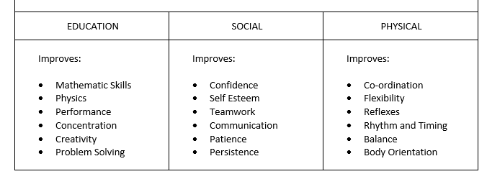
Task 4 – Flyer (5 marks) (cont)
Indentation – the bullets should not be indented, this does not mean that the heading is indented. The following is incorrect:
If there are more than 10 words omitted DNA 2K.
DNA 1P if the template is
amended.

Slide 23
Task 5 – Mail Merge (5 marks)
Check the headed paper – look for the footer and check alignment (if it was on Task 1).
If the candidate has included their own name and job title the P is still available.
Ignore EXAMREF in the footer on any page.
If the candidate uses an address block that changes the position of the page break – look at the merged letter for the inside name and address and page break marks.
If the letter is on one page DNA 1PB.

Slide 24
Task 6 – E-mail (6 marks)
If candidates have created a new e-mail, the subject heading must be accurate.
Any word document can be attached.
Check the capitalisation of acrobatic skills workshop.
Second address does not need to be CC.

Slide 25
Task 7 – Poster (4 marks)
The ticket costs section must be identical to the task in the assignment.
Presentation mark – candidates must use at least 2/3rds of the page.
Additional information might be included – check for keyboarding.
If Stornoway is in the location it must be:
Lews Castle, Stornoway or
Lews Castle
Stornoway

Slide 26
Task 8 – Programme (7 marks)
Border should be on page 1 only.
The text formatting should be correct in the moved acts and new act or DNA 1P.
The thick border on the table must be on the outside, but can also be on the inside lines.
DNA 1P if there are other changes to the template:
Act One no longer centred or bold
If Stornoway is included must be:
Lews Castle, Stornoway or
Lews Castle
Stornoway

Slide 27
Task 9 – Presentation (12 marks)
Slide 1 – If Stornoway is included must be:
Lews Castle, Stornoway or
Lews Castle
Stornoway
Slide 3 – Numbers must be keyed-in, not the bullets.
Slide 3 – Must be ‘Keep personal…’, not ‘Keep all personal…’
Slide 4 – Be careful that the pictures don’t cover the lines of the table.

Slide 28
Task 9 – Presentation (12 marks) (cont)
Slide 5 – The table inserted into the presentation should be the same as the table in the programme.
Slide 5 – Ignore any design/formatting of the inserted table.
If additional information/features are added incorrectly, ie adding a logo on other slides, but it incorrectly covers text or another graphic, or inserting a background which covers text DNA 1P.
Ignore if the candidate name is on the same line as requested information.

Slide 29
Task 10 – Internet Printouts (5 marks)
Many candidates have included walking directions, instead of driving.
The American date is shown on some flight websites – do not penalise the candidate for this.
The newspaper and phone number must be from the internet, not just a keyed-in name and phone number.

Slide 30
Additional Information
Three candidate examples, with accompanying commentaries.
Theory Workshop

